Slide 1
Finding the Efficient Set
(Chapter 5)
Feasible Portfolios
Minimum Variance Set & the Efficient Set
Minimum Variance Set Without Short-Selling
Key Properties of the Minimum Variance Set
Relationships Between Return, Beta, Standard Deviation, and the Correlation Coefficient

Slide 2
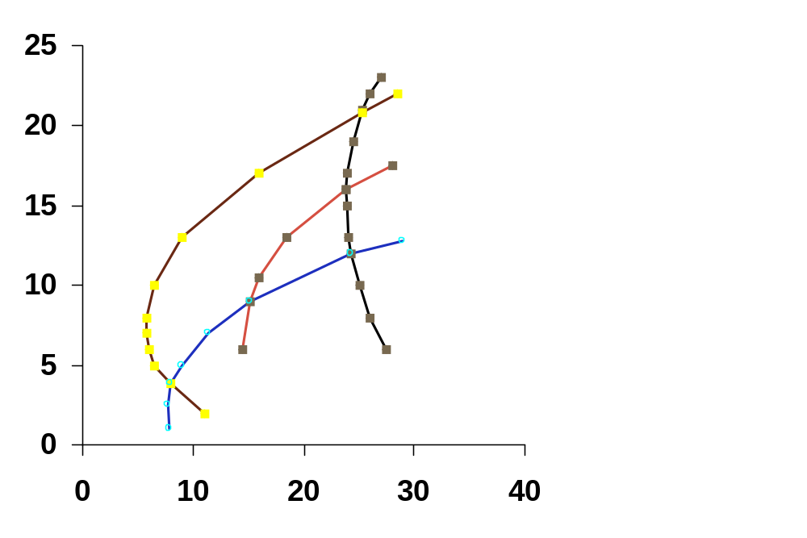
FEASIBLE PORTFOLIOS
When dealing with 3 or more securities, a complete mass of feasible portfolios may be generated by varying the weights of the securities:
Expected Rate of Return (%)
Stock 1
Portfolio of Stocks 1 & 2
Stock 2
Portfolio of Stocks 2 & 3
Stock 3
Standard Deviation of Returns (%)

Slide 3
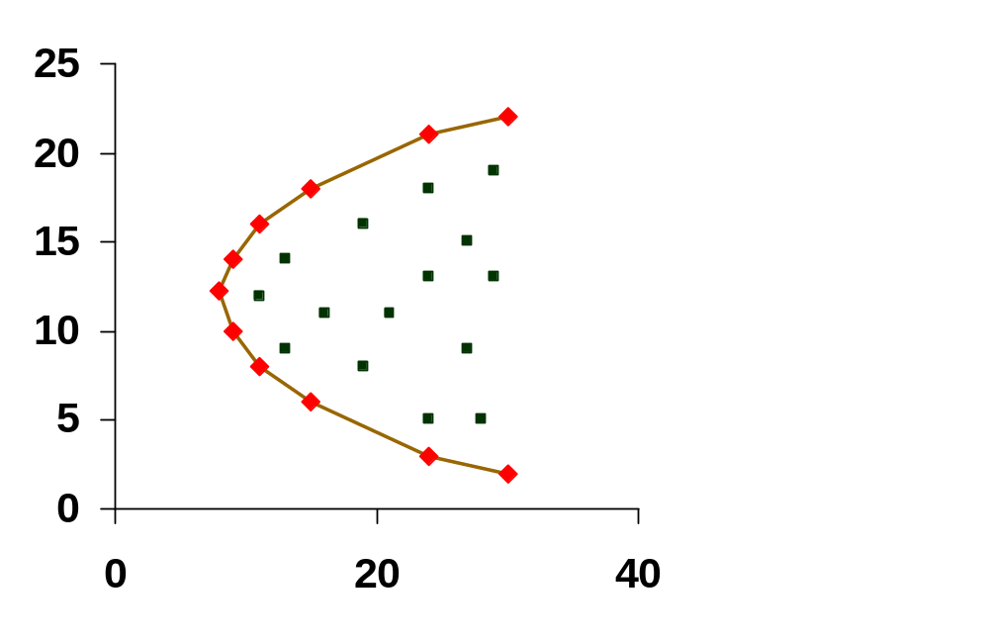
Minimum Variance Set and the
Efficient Set
Minimum Variance Set: Identifies those portfolios that have the lowest level of risk for a given expected rate of return.
Efficient Set: Identifies those portfolios that have the highest expected rate of return for a given level of risk.-
Expected Rate of Return (%)
Efficient Set (top half of the
Minimum Variance Set)
MVP
Minimum Variance Set
Note: MVP is the global minimum
variance portfolio (one with the
lowest level of risk)
Standard Deviation of Returns (%)

Slide 4
Finding the Efficient Set
In practice, a computer is used to perform the numerous mathematical calculations required. To illustrate the process employed by the computer, discussion that follows focuses on:
1. Weights in a three-stock portfolio, where:
  Weight of Stock A = x_{A}
  Weight of Stock B = x_{B}
  Weight of Stock C =1 - x_{A} - x_{B}
    and the sum of the weights equals 1.0
2. Iso-Expected Return Lines
3. Iso-Variance Ellipses
4. The Critical Line

Slide 5
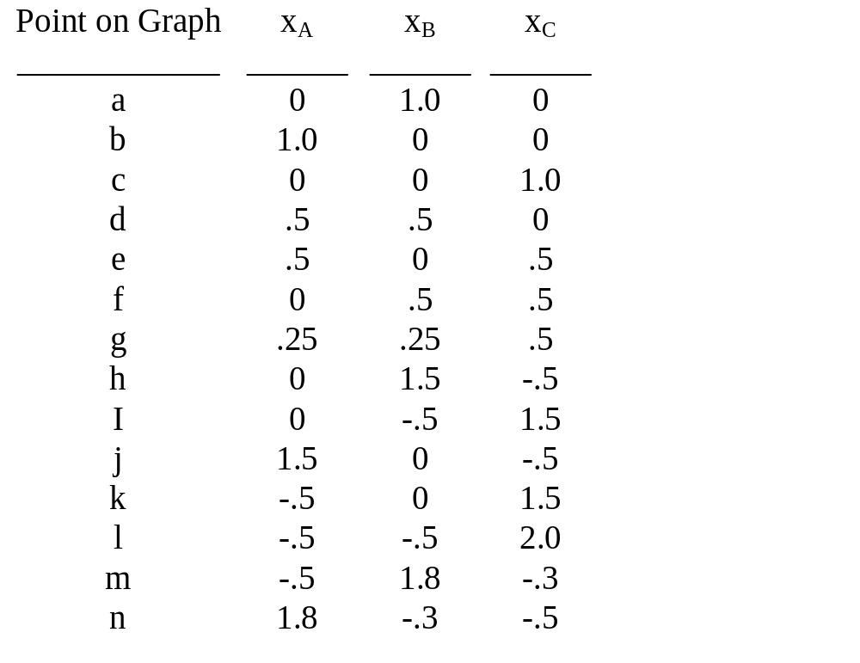
Weights in a Three-Stock Portfolio
(Data Below Pertains to the Graph That Follows)
Invest in only one stock
(Corners of the triangle)
Invest in only two stocks
(Perimeter of the triangle)
Invest in all three stocks
(Inside the triangle)
Short-selling occurs
when you are outside
the triangle

Slide 6
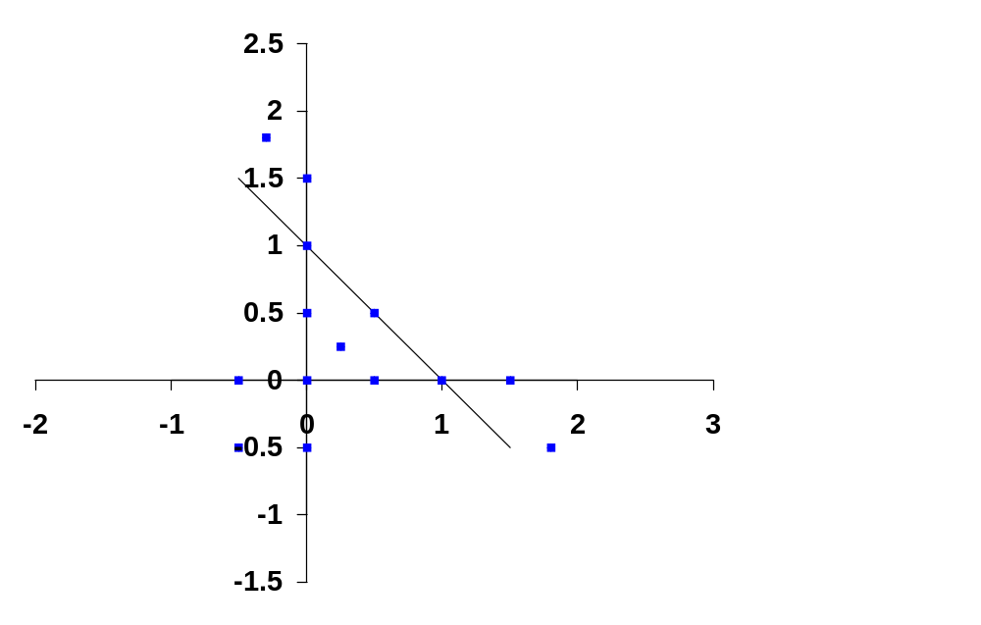
Weights in a Three-Stock Portfolio
(Continued)
(Graph of Preceding Data)
Weight of Stock B
m
h
a
f
d
k
g
b
j
c
Weight of Stock A
e
l
i
n

Slide 7
Iso-Expected Return Lines
In the graph below, the iso-expected return line is a line on which all portfolios have the same expected return.
Given x_{A} = weight of stock (A), and x_{B} = weight of stock (B), the iso-expected return line is:
x_{B} = a₀ + a₁x_{A}
Once a₀ + a₁ have been determined, we can solve for a value of x_{B} and an implied value of x_{C}, for any given value of x_{A}

Slide 8
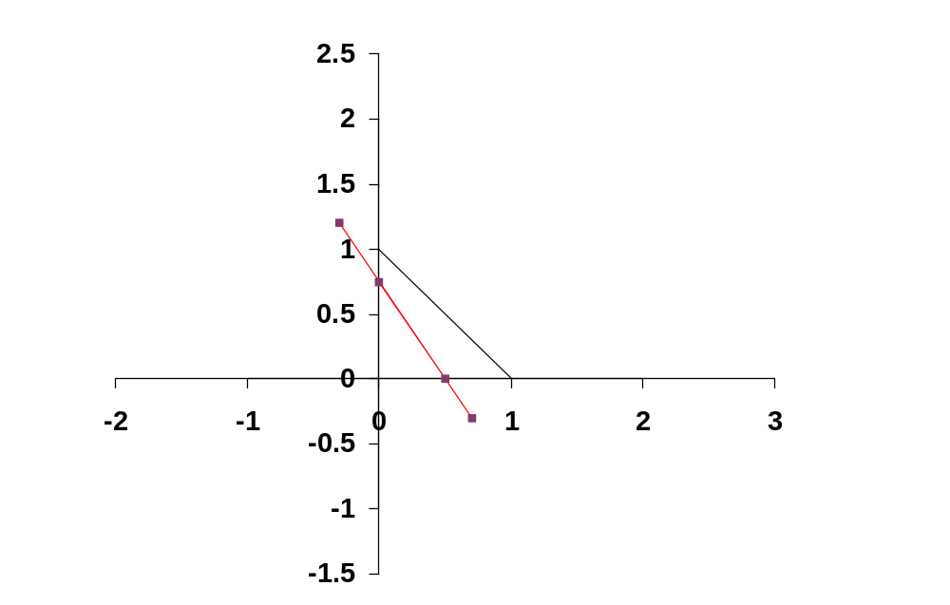
Iso-Expected Return Line
(A graphical representation)
Weight of Stock B
x_{B} = a₀ + a₁x_{A}
a₀ = the intercept
a₁ = the slope
Weight of Stock A
Iso-Expected Return Line

Slide 9
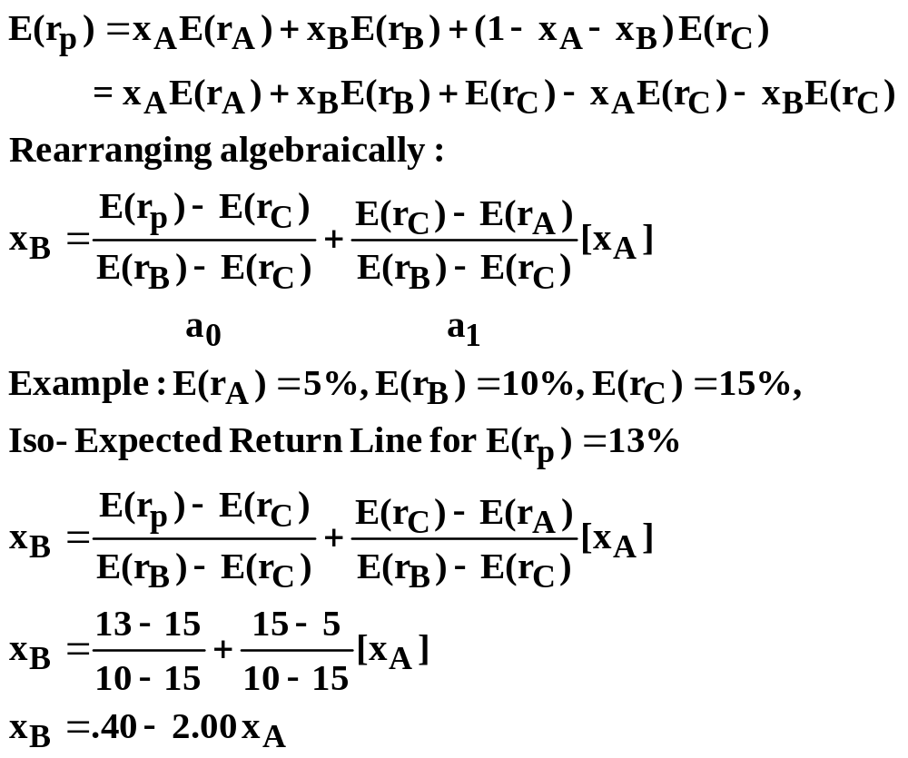
Computing the Intercept and Slope of an
Iso-Expected Return Line

Slide 10
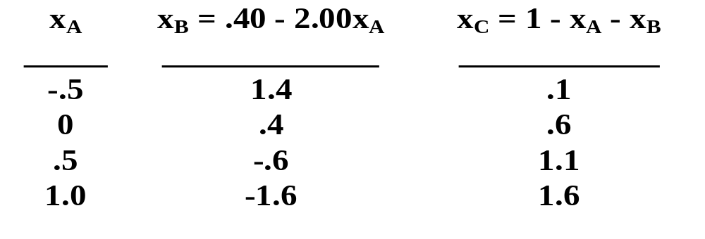
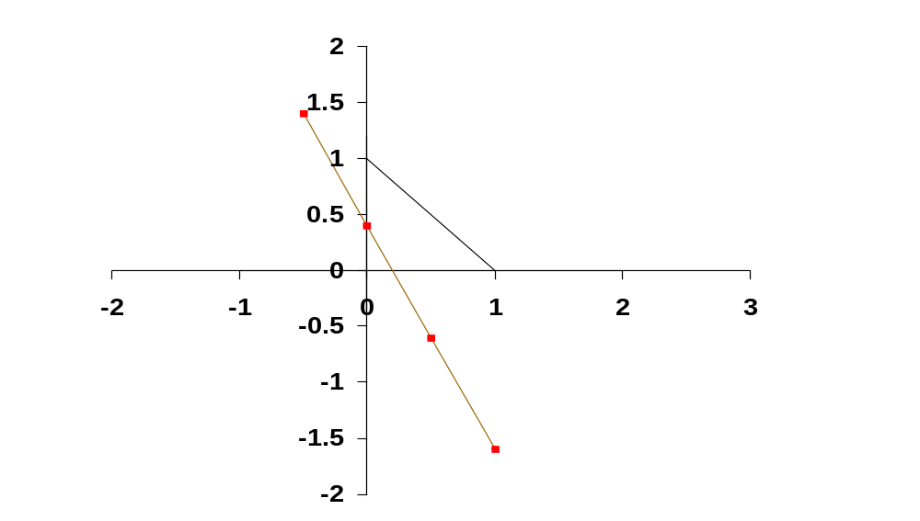
Iso-Expected Return Line for a
Portfolio Return of 13%
x_{B}
x_{A}
Iso-Expected Return Line
For E(r_{p}) = 13%

Slide 11
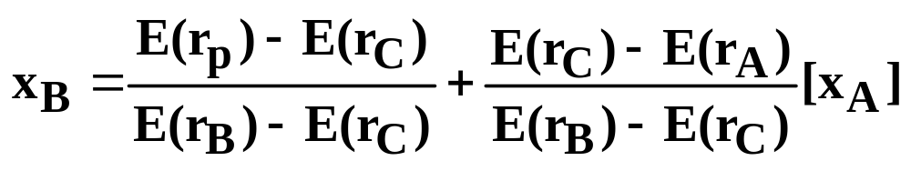
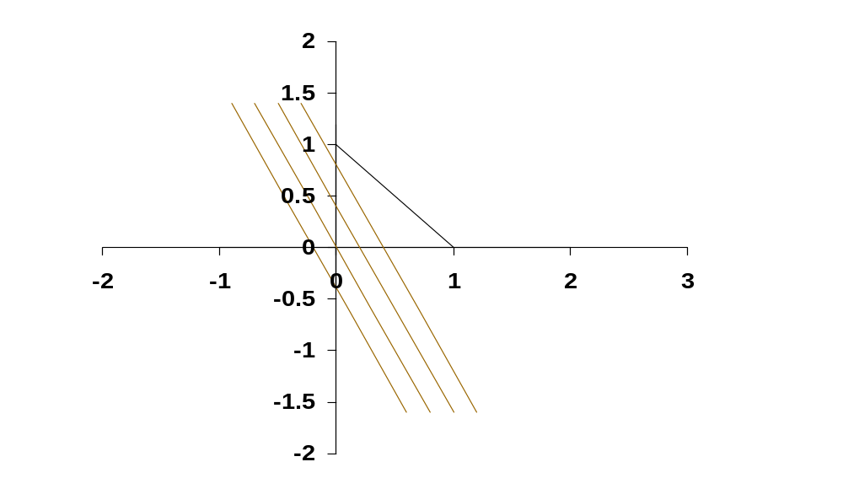
A Series of Iso-Expected Return Lines
By varying the value of portfolio expected return, E(r_{p}), and repeating the process above many times, we could generate a series of iso-expected return lines.
Note: When E(r_{p}) is changed, the intercept (a₀) changes, but the slope (a₁) remains unchanged.
x_{B}
x_{A}
Series of Iso-Expected Return
Lines in Percent
17 15 13 11

Slide 12
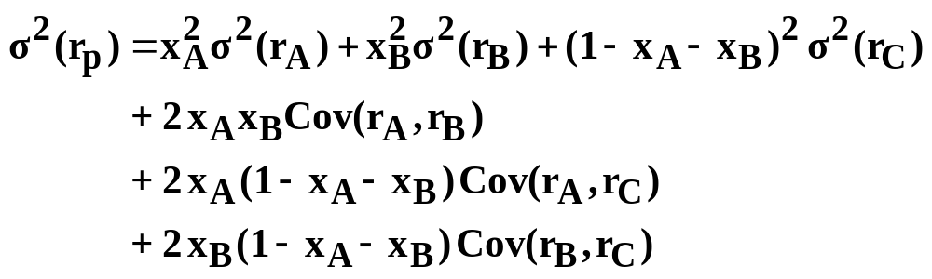
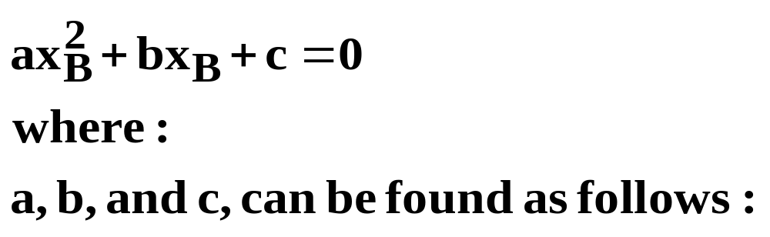
Iso-Variance Ellipse
(A Set of Portfolios With Equal Variances)
First, note that the formula for portfolio variance can be rearranged algebraically in order to create the following quadratic equation:

Slide 13
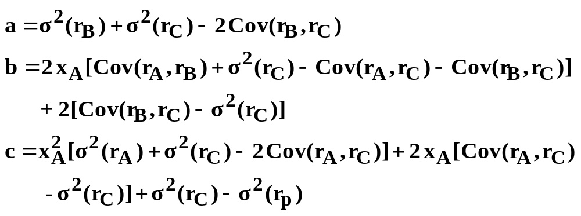
Iso-Variance Ellipse (Continued)
Next, the equation can be simplified further by substituting the values for individual security variances and covariances into the formula.

Slide 14
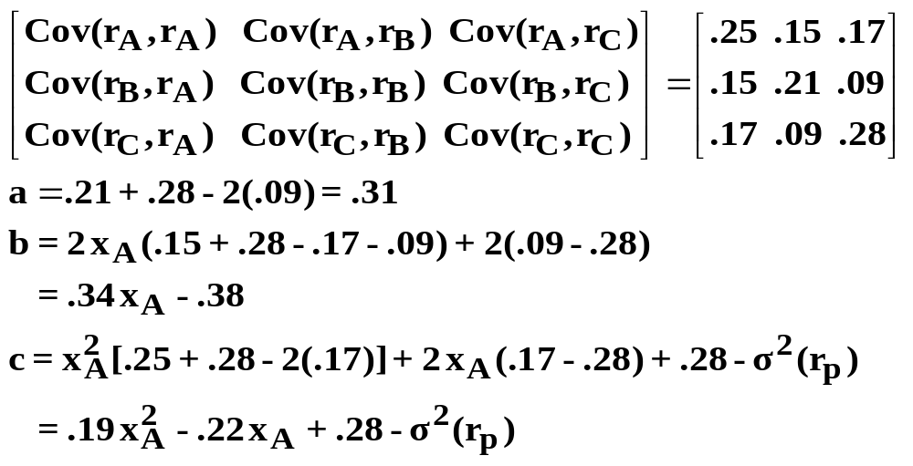
Iso-Variance Ellipse (An Example)
Given the covariance matrix for Stocks A, B, and C:
Therefore, in terms of ax_{B}² + bx_{B} + c = 0
Now, for a given σ²(r_{p}), we can create an iso-variance ellipse.

Slide 15
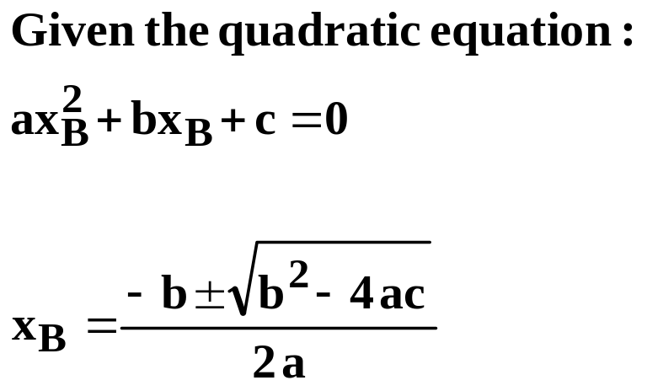
Generating the Iso-Variance Ellipse for a
Portfolio Variance of .21
1. Select a value for x_{A}
2. Solve for the two values of x_{B}
Review of Algebra:
3. Repeat steps 1 and 2 many times for numerous values of x_{A}

Slide 16
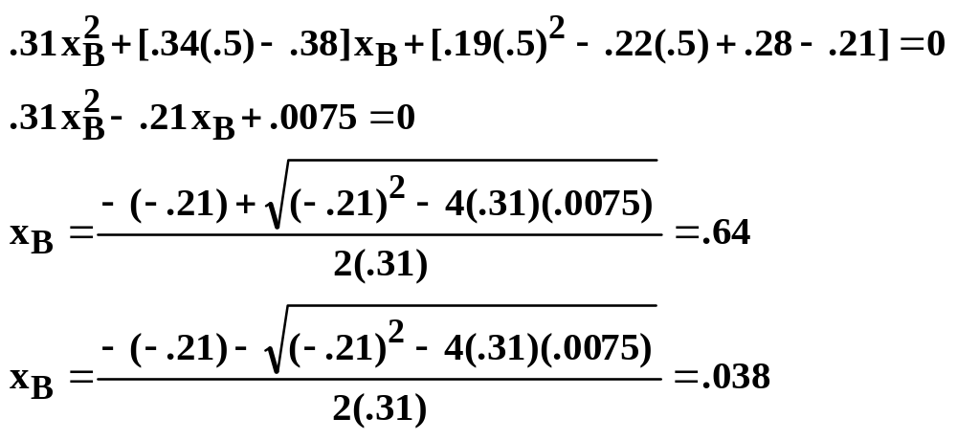
Generating the Iso-Variance Ellipse for a
Portfolio Variance of .21 (Continued)
Example: x_{A} = .5

Slide 17
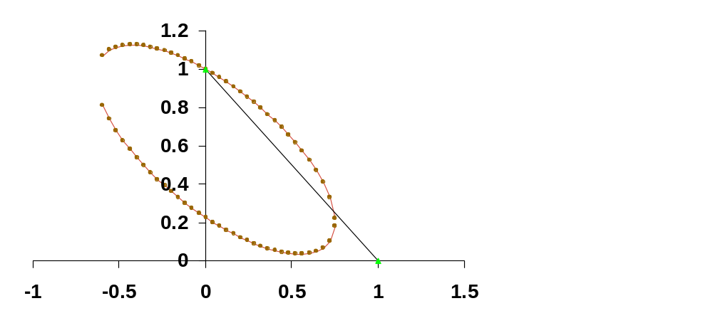
Generating the Iso-Variance Ellipse for a
Portfolio Variance of .21 (Continued)
A weight of .5 is simply one possible value for the weight of Stock (A). For numerous values of x_{A} you could solve for the values of x_{B} and plot the points in x_{B} x_{A} space:
x_{B}
Iso-Variance Ellipse for
σ²(r_{p}) = .21
.21
x_{A}

Slide 18
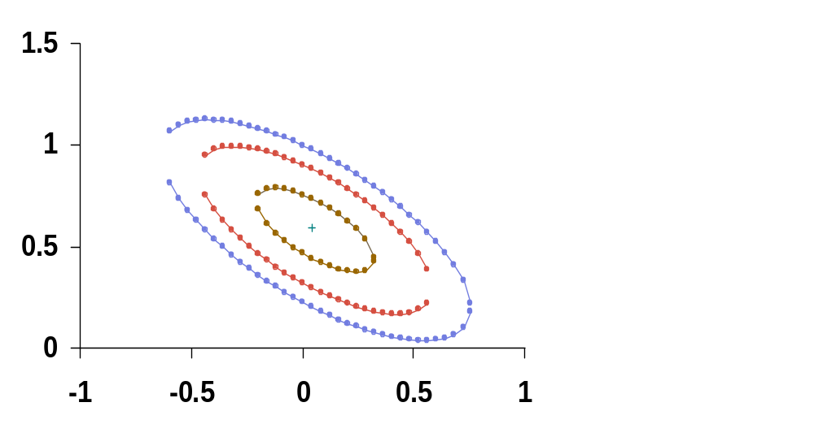
Series of Iso-Variance Ellipses
By varying the value of portfolio variance and repeating the process many times, we could generate a series of iso-variance ellipses. These ellipses will converge on the MVP (the single portfolio with the lowest level of variance).
x_{B}
.21
.19
.17
MVP
x_{A}

Slide 19
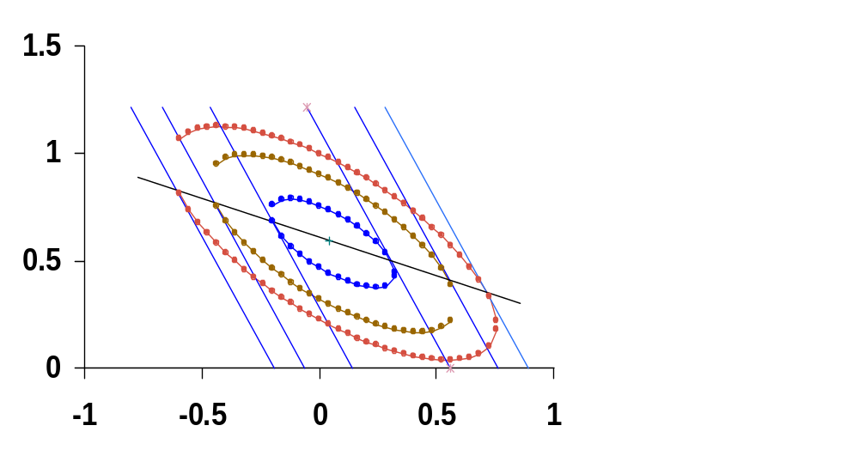
The Critical Line
Shows the portfolio weights for the portfolios in the minimum variance set. Points of tangency between the iso-expected return lines and the iso-variance ellipses. (Mathematically, these points of tangency occur when the 1st derivative of the iso-variance formula is equal to the 1st derivative of the iso-expected return line.)
x_{B}
16.9 15.6 13.6 9.4 7.4 6.1
.21
.19
.17
Critical Line
MVP
x_{A}

Slide 20
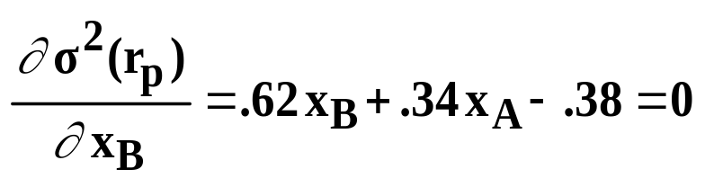
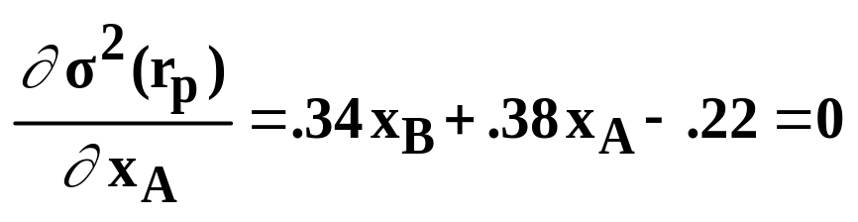
Finding the Minimum Variance Portfolio (MVP)
Previously, we generated the following quadratic equation:
Rearranging, we can state:
1. Take the 1st derivative with respect to x_{B}, and set it equal to 0:
2. Take the 1st derivative with respect to x_{A}, and set it equal to 0:
3. Simultaneously solving the above two derivatives for x_{A} & x_{B}:
x_{A} = .06 x_{B} = .58 x_{C} = .36

Slide 21
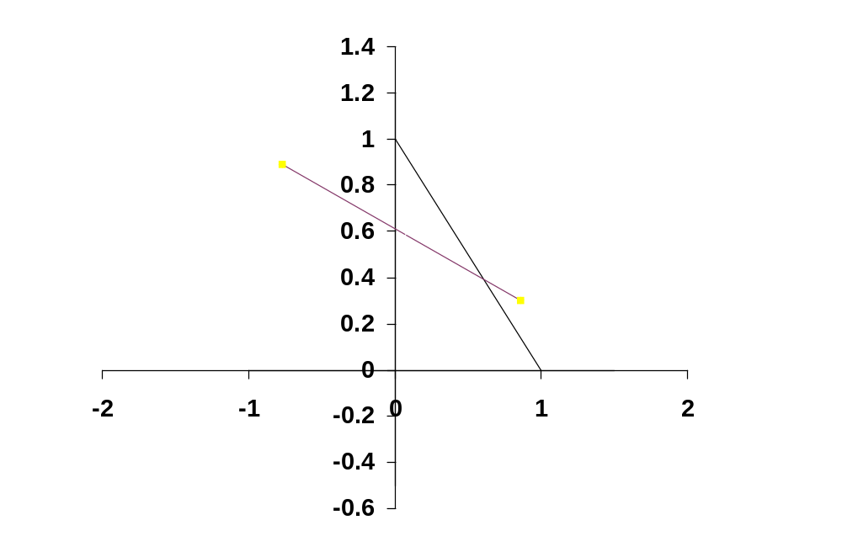
Relationship Between the Critical Line and the Minimum Variance Set
x_{B}
C
MVP
Critical Line
*
D
x_{A}

Slide 22
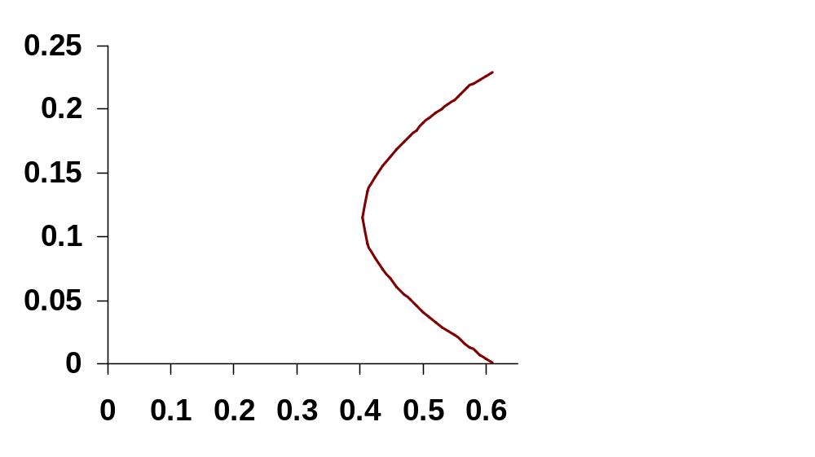
Relationship Between the Critical Line and the Minimum Variance Set (Continued)
Expected Return
C
Minimum Variance Set
MVP
*
D
Standard Deviation of Returns

Slide 23

Minimum Variance Set When Short-Selling is Not Allowed (Critical Line Passes Through the Triangle)
x_{B}
Critical Line Passes
Through the Triangle
MVP
*
x_{A}

Slide 24
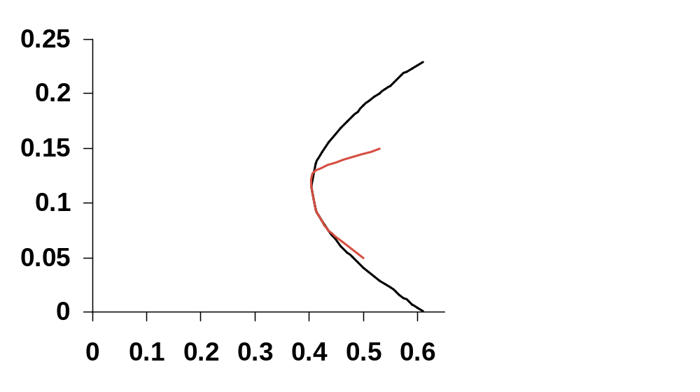
Minimum Variance Set When Short-Selling is Not Allowed (Critical Line Passes Through the Triangle)
CONTINUED
Expected Return
With Short-Selling
Stock (C)
MVP
*
Without Short-Selling
Stock (A)
Standard Deviation of Returns

Slide 25
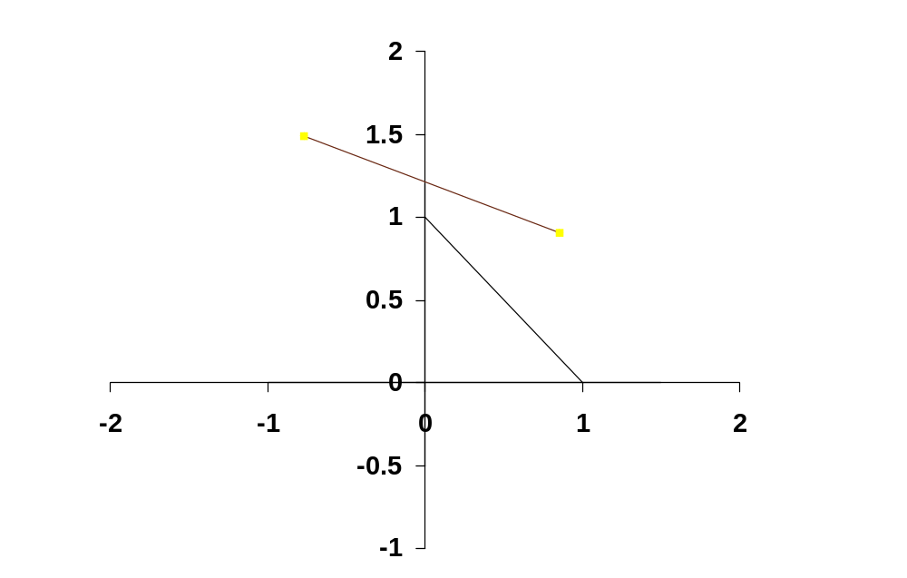
Minimum Variance Set When Short-Selling is Not Allowed (Critical Line Does Not Pass Through the Triangle)
x_{B}
Critical Line Does Not Pass
Through the Triangle
x_{A}

Slide 26
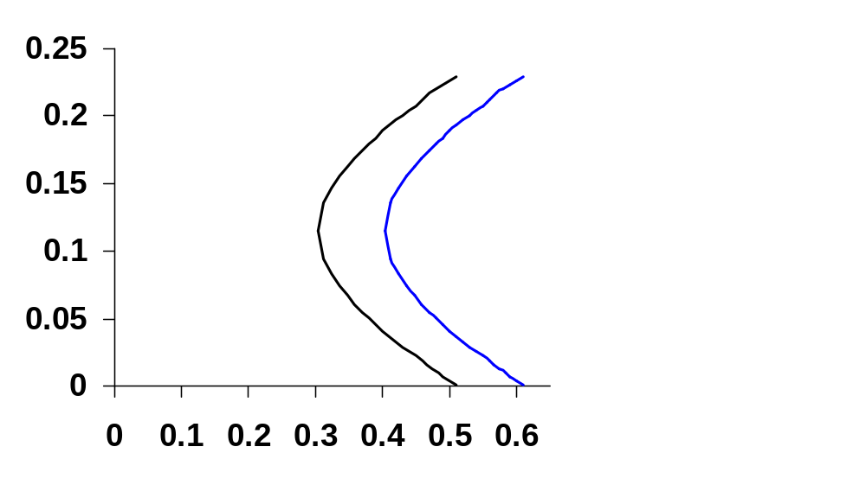
Minimum Variance Set When Short-Selling is Not Allowed (Critical Line Does Not Pass Through the Triangle)
CONTINUED
Expected Return
With Short-Selling
Without Short Selling
Standard Deviation of Returns

Slide 27
The Minimum Variance Set:
(Property I)
If we combine two or more portfolios on the minimum variance set, we get another portfolio on the minimum variance set.
Example: Suppose you have $1,000 to invest. You sell portfolio (N) short $1,000 and invest the total $2,000 in portfolio (M). What are the security weights for your new portfolio (Z)?
Portfolio N: x_{A} = -1.0, x_{B} = 1.0, x_{C} = 1.0
Portfolio M: x_{A} = 1.0, x_{B} = 0, x_{C} = 0
Portfolio Z: x_{A} = -1(-1.0) + 2(1.0) = 3.0
x_{B} = -1(1.0) + 2(0) = -1.0
x_{C} = -1(1.0) + 2(0) = -1.0

Slide 28
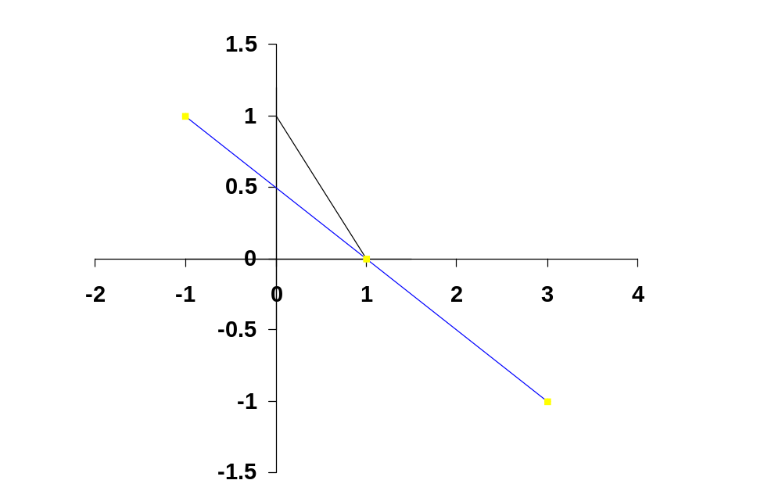
The Minimum Variance Set: (Property I)
CONTINUED
X_{B}
N
M
X_{A}
Z

Slide 29
The Minimum Variance Set:
(Property II)
Given a population of securities, there will be a simple linear relationship between the beta factors of different securities and their expected (or average) returns if and only if the betas are computed using a minimum variance market index portfolio.

Slide 30
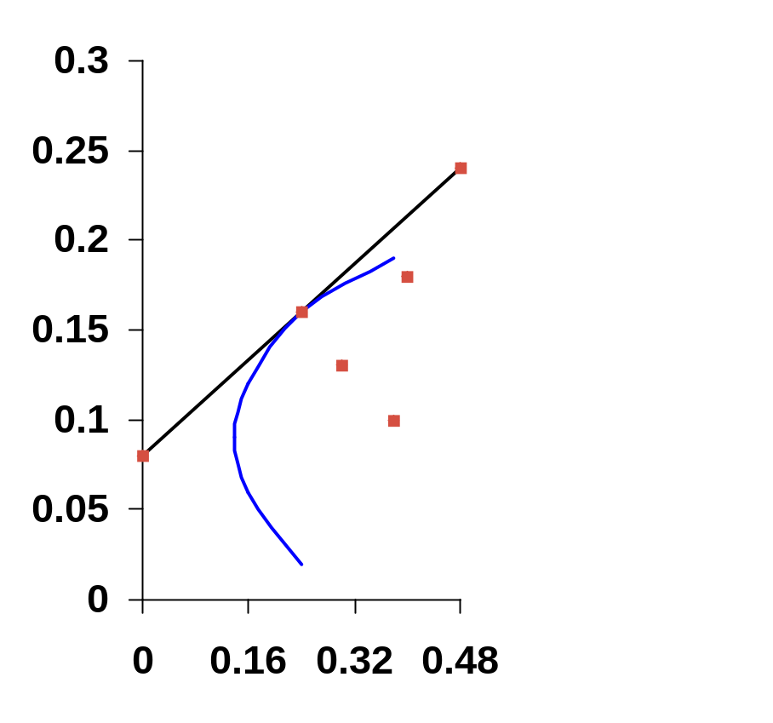
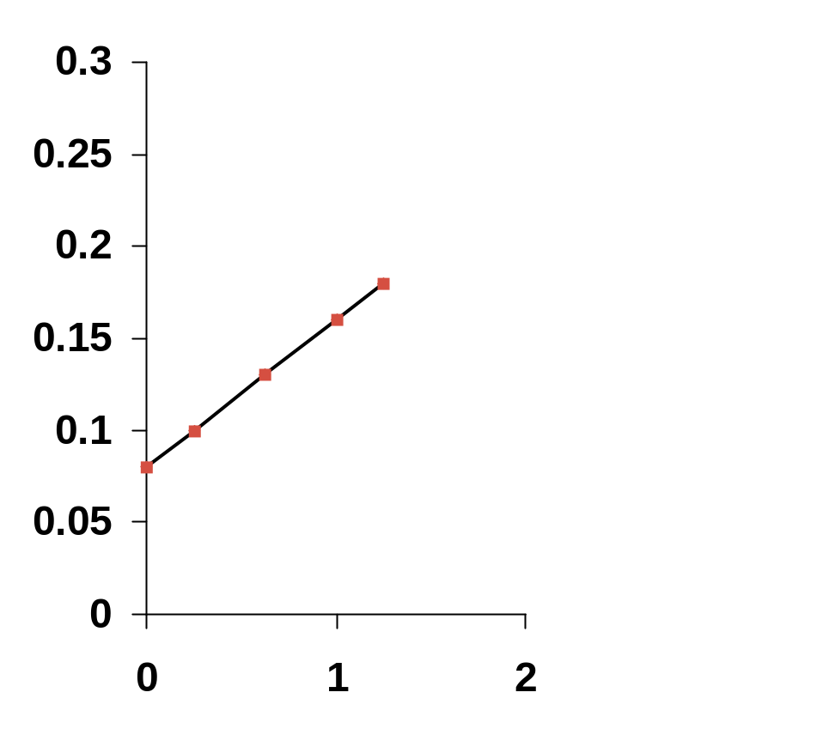
The Minimum Variance Set: (Property II)
CONTINUED
E(r)
E(r)
C
M
C
M
B
B
A
E(r_{Z})
A
E(r_{Z})
σ(r)
β

Slide 31
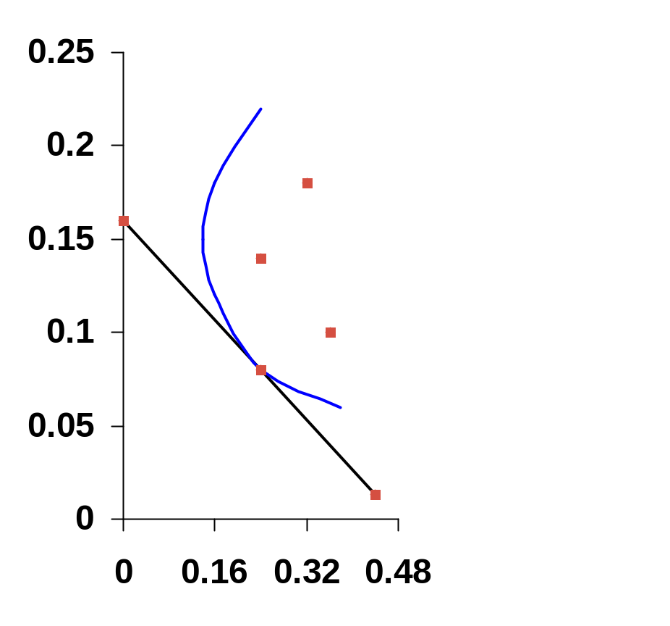
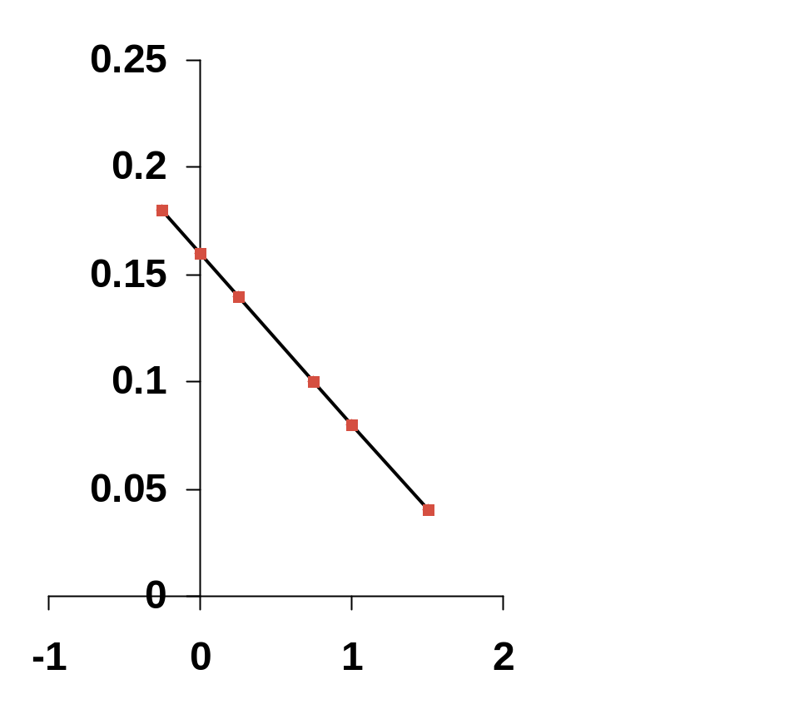
The Minimum Variance Set: (Property II)
CONTINUED
E(r)
E(r)
E(r_{Z})
C
C
E(r_{Z})
A
A
B
B
M
M
σ(r)
β

Slide 32
Notes on Property II
The intercept of a line drawn tangent to the bullet at the position of the market index portfolio indicates the return on a zero beta security or portfolio, E(r_{Z}).
By definition, the beta of the market portfolio is equal to 1.0 (see the following graph).
Given E(r_{Z}) and the fact that β_{Z} = 0, and E(r_{M}) and the fact that β_{M} = 1.0, the linear relationship between return and beta can be determined.

Slide 33
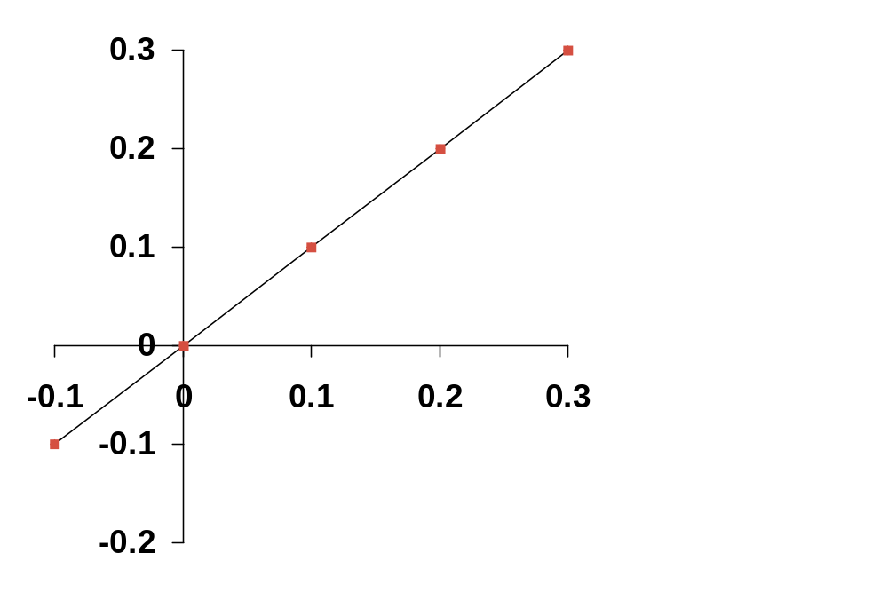
Notes on Property II
CONTINUED
r_{M}
= β_{M} = 1.00
r_{M}

Slide 34
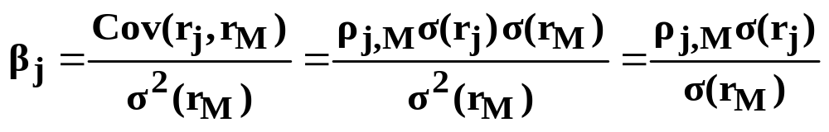
Return, Beta, Standard Deviation, and the Correlation Coefficient
In the following graph, portfolios M, A, and B, all have the same return and the same beta.
Portfolios M, A, and B, have different standard deviations, however. The reason for this is that portfolios A and B are less than perfectly positively correlated with the market portfolio (M).

Slide 35
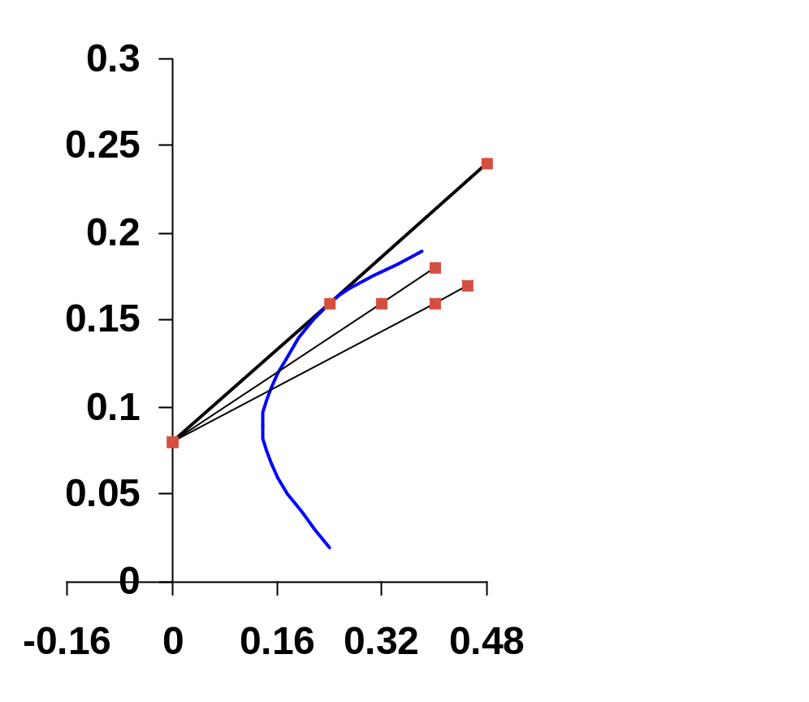
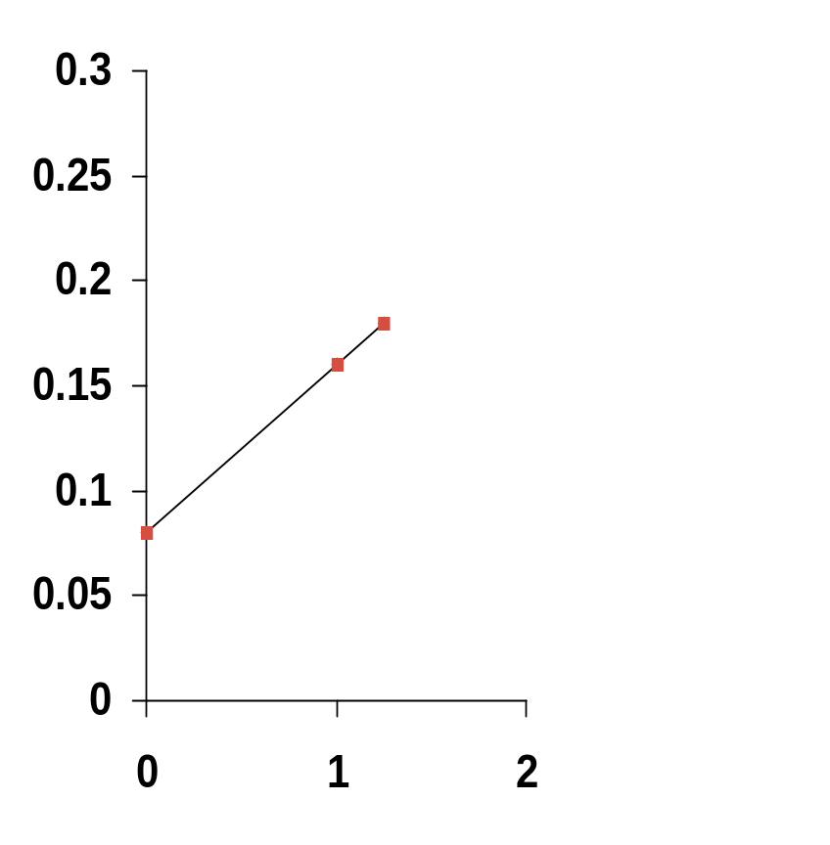
Return, Beta, Standard Deviation, and the Correlation Coefficient (Continued)
E(r)
E(r)
ρ_{j,M} = 1.0
ρ_{j,M} = .7
M
ρ_{j,M} = .5
M, A, B
A
B
E(r_{Z})
E(r_{Z})
σ(r)
β

Slide 36
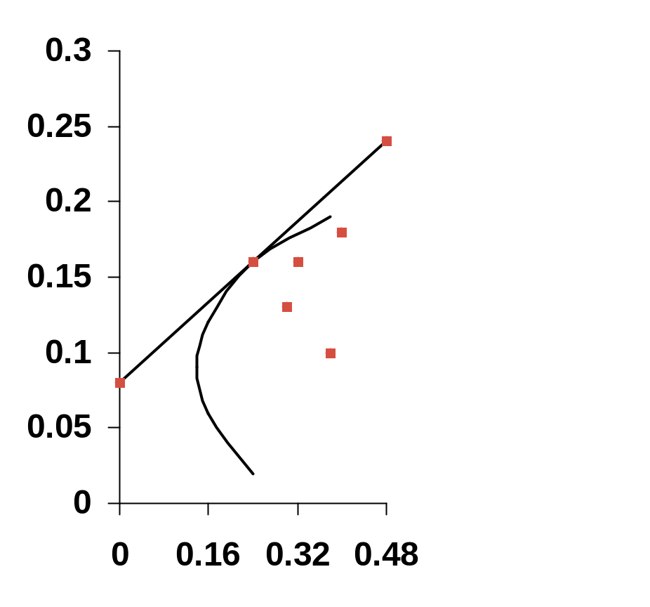
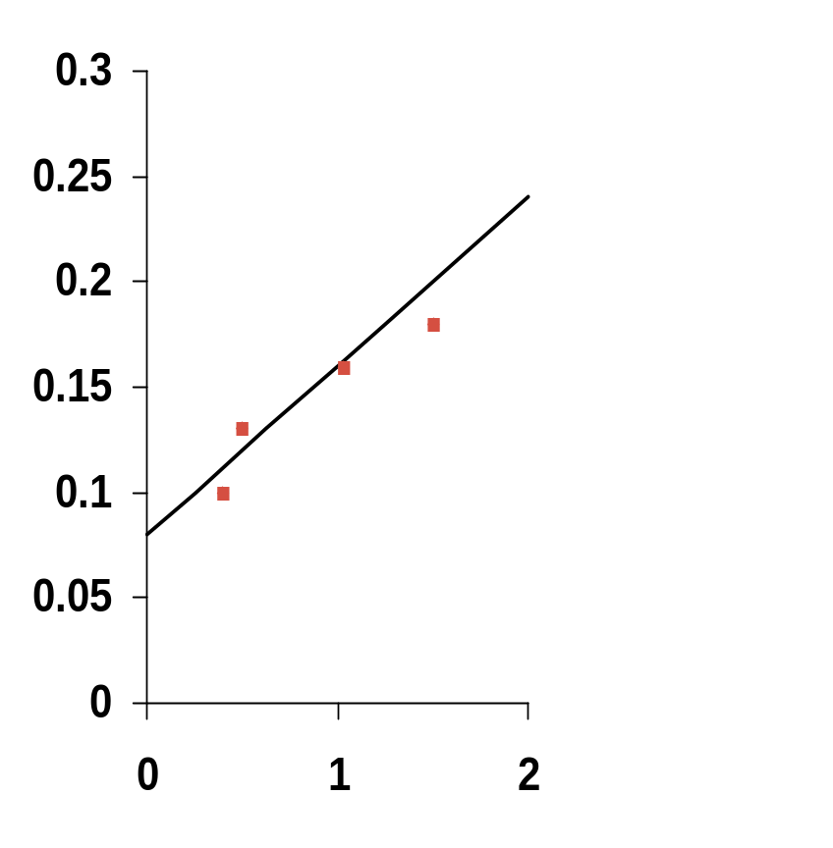
Return Versus Beta When the Market Portfolio (M**) is Inefficient
E(r)
E(r)
C
C
M
M**
M**
A
A
B
B
σ(r)
β

